Slide 1
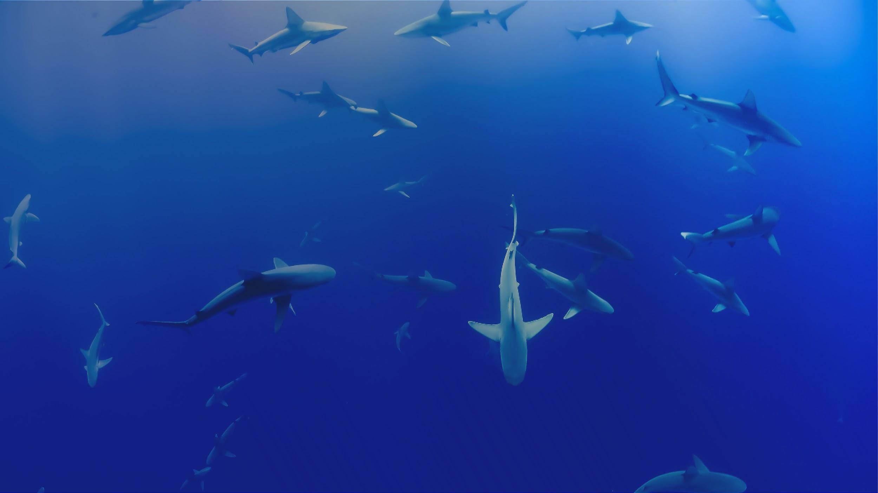


OBIS Training - Jan 2020
Jon Pye, Brian Jones, Naomi Tress
Ocean Tracking Network Data Centre

Slide 2


ABOUT OTN
Global aquatic research, data management and partnership platform headquartered at Dalhousie University in Nova Scotia, Canada.
Since 2008, OTN has been deploying state-of-the-art ocean monitoring equipment and marine autonomous vehicles (gliders) in key aquatic locations.
OTN has established partnerships with a global community of stakeholders to document the movements and survival of aquatic animals in the context of changing ocean environments.
Knowledge generated by OTN is used by scientists, managers, policy-makers, industry, Indigenous and coastal communities and the general public.
OCEAN TRACKING NETWORK
Notes:
First, a bit about who we are. The Ocean Tracking Network is an aquatic research, data management, and partnership platform at Dalhousie University. We focus on biologging and electronic means of determining animal presence, especially acoustic telemetry. We partner with many stakeholders to make sure that data collected by researchers is used optimally and becomes part of the knowledge base used by decision makers, coastal communities, and the public at large.

Slide 3
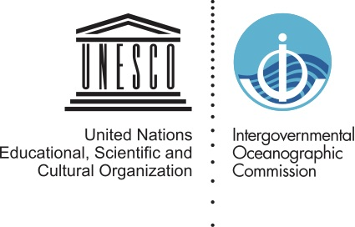

OBIS:
A biodiversity information
system in the
UN ocean decade
adapted from a presentation by Eduardo Klein, OBIS SG
eklein@usb.ve
Notes:
To that end, OTN is a participating node of the Ocean Biogeographic Information System, which is a UNESCO-Intergovernmental Oceanographic Commission initiative to aggregate and make available the world’s understanding of marine animal presence and biodiversity. Our data, once released publicly, joins a huge and wide-ranging data system of all the ways in which humans (and our machines) have determined the presence of marine taxa in space and time.

Slide 4
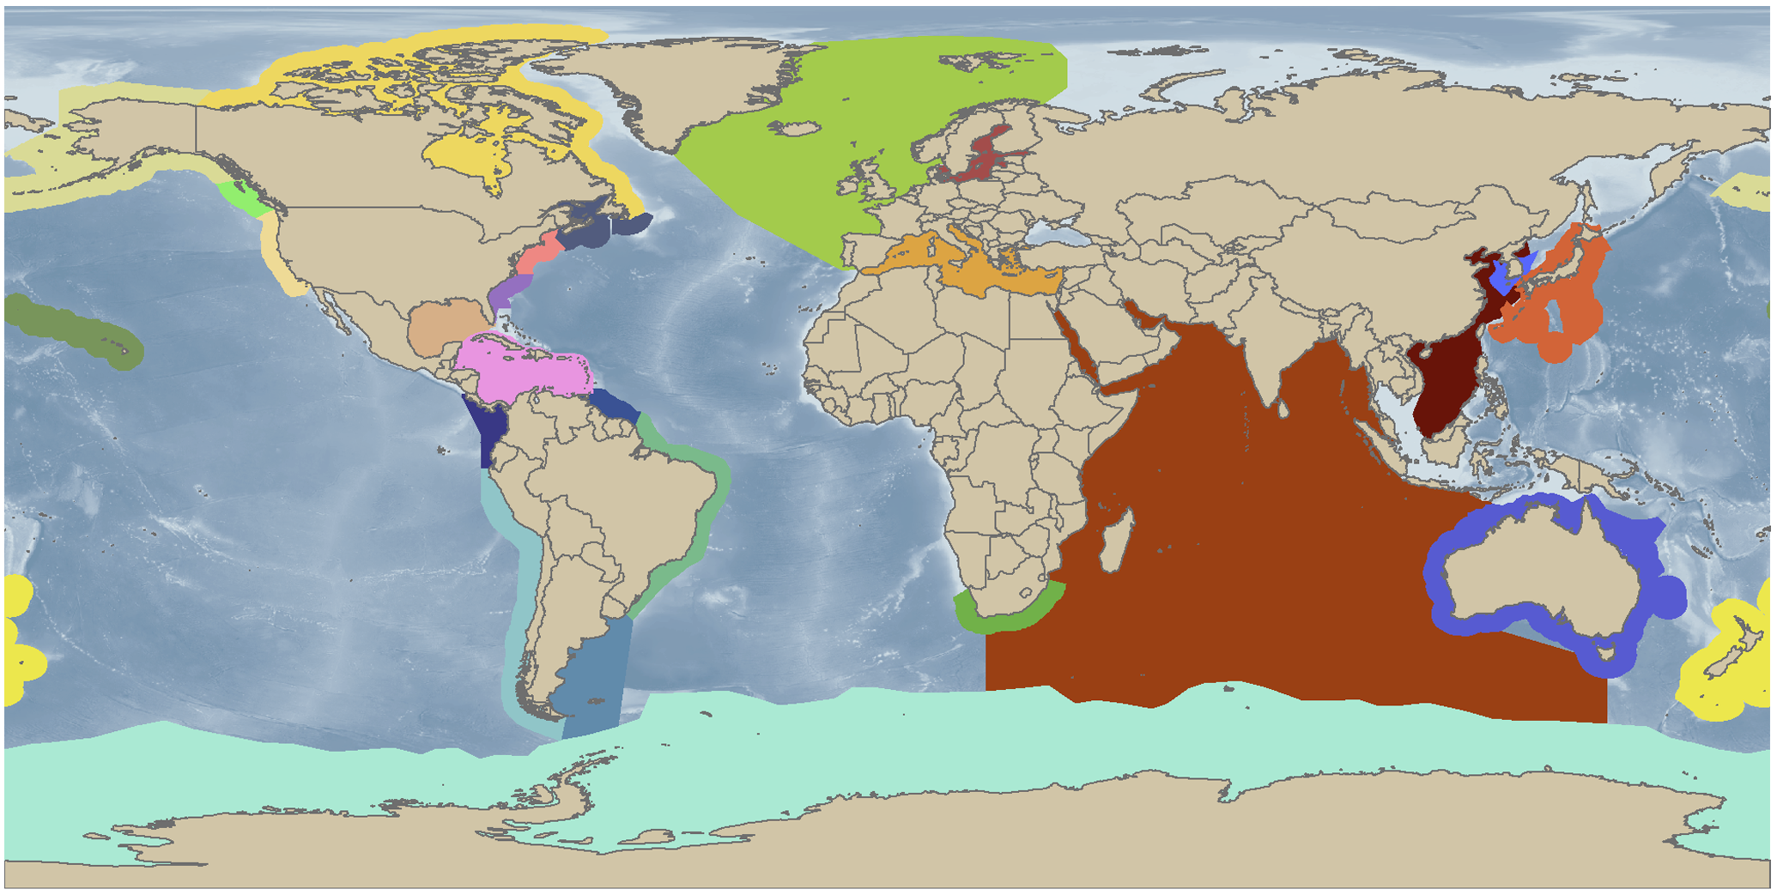

A brief history of OBIS...
2000-2010: OBIS was created as data repository and information dissemination for the 16 projects of the CoML and the regional committees.
2009: the project was adopted by the Intergovernmental Oceanographic Commission (IOC-UNESCO) under the IODE programme (IOC Resolution XXV-4)
2011: the Secretariat and iOBIS was moved from Rutgers University, USA to Oostende, Belgium
Notes:
OBIS came about as part of the Census of Marine Life in the year 2000, which is the same over-arching initiative that resulted in the establishment of OTN in 2008. As the 10 year Census of Marine Life programme wound down, OBIS was adopted by the Intergovernmental Oceanographic Commission of UNESCO (IOC-UNESCO). IOC was established in 1960 as a body with functional autonomy within UNESCO, and is the primary organization responsible for marine science within the UN system. http://ioc-unesco.org/
UNESCO is the United Nations Educational, Scientific and Cultural Organization. It seeks to build peace through international cooperation in Education, the Sciences and Culture. UNESCO's programmes contribute to the achievement of the Sustainable Development Goals defined in Agenda 2030, adopted by the UN General Assembly in 2015. https://en.unesco.org/ The headquarters for the international OBIS is now next to the IOC-UNESCO project office in Oostende, Belgium, physically very near to the Flanders Marine Institute as well.

Slide 5
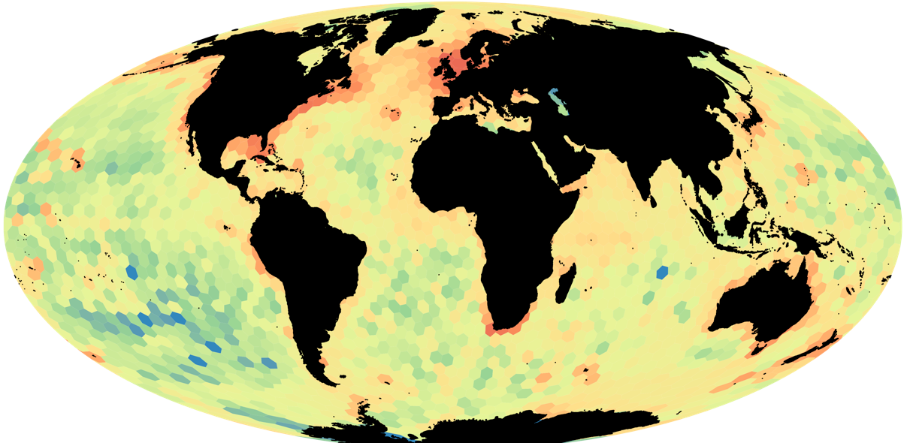
OBIS – THE Ocean Biogeographic Information System
>58 million records
>127,500 marine species
>3000 datasets
>800 institutions
33 OBIS regional / thematic nodes
Notes:
So OBIS is now home to 58 million records of animal presence, across 127,500 marine species from phytoplankton to marine mammals to sharks, has over 3000 datasets harvested from its 33 member nodes who interact with over 800 institutions to ensure their data is part of this picture. OTN is a thematic node dealing with all data about tagged individual animals, and OBIS Canada is the national OBIS node, headed up by Bruce Patten at DFO Pacific in Nanaimo.

Slide 6
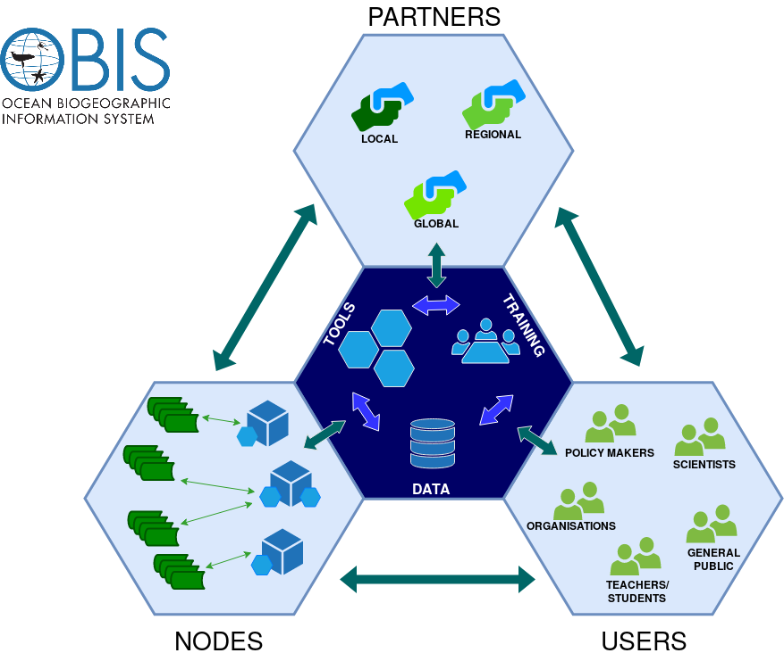
"To build and maintain a global alliance that collaborates with scientific communities to facilitate free and open access to, and application of, biodiversity and biogeographic data and information on marine life."
Notes:
OBIS’s mission is to maintain this global alliance of research data partners and provide free and open access to and application of biodiversity and biogeographic data and information on marine life. As a member node, I can tell you their real mission is to make sure you don’t put any badly formed Darwin core archives where they can see it. To be serious though, OBIS has a responsibility to train data managers like me and you, aggregate data and provide tools to help make sense of it. It’s a good mission and an opportunity to add a lot of value to the data we and our scientific partners are collecting every day.

Slide 7
Notes:
Here’s where all the OBIS nodes and partners are geographically, as OBIS has an obligation by its UN backers to be generating capacity and knowledge in all the countries of the world, there’s a great deal of focus on making each national or regional node independent and autonomous and reflective of the people that it serves.

Slide 8
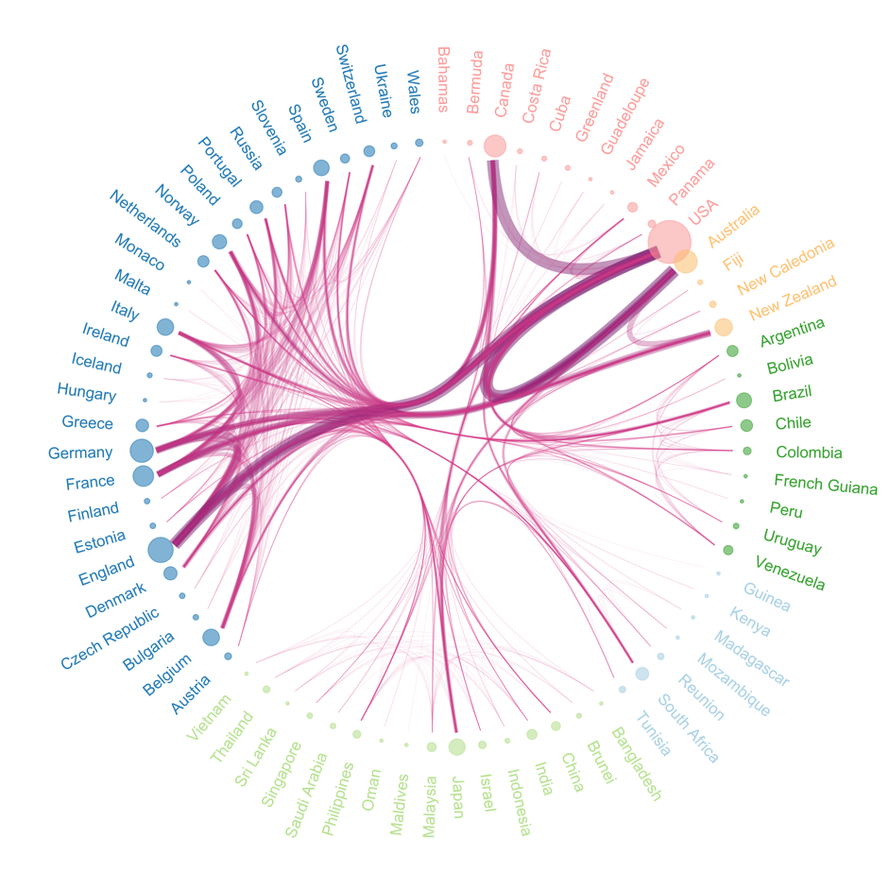
Open-access to research data supports equitable access and benefit sharing and enhances international
collaboration
2700 scientists from 73 countries collaborated on >1000 papers citing OBIS
(based on Web of Science, in collaboration with VLIZ)
Notes:
OBIS demonstrates strong support for open-access to research data, and has seen positive results for its efforts so far. Good Data Management and Best Practices are of course a must for truly open-access, interoperable data, and the benefits to international collaboration are quantifiable and worth the effort we all undertake to make our data ready for the world.

Slide 9
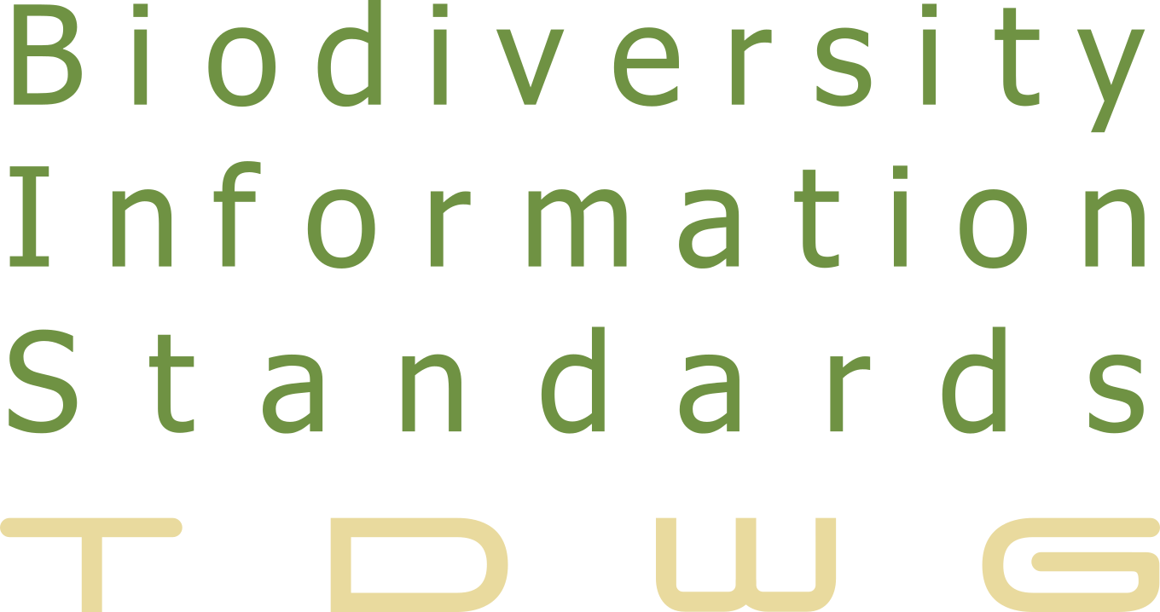
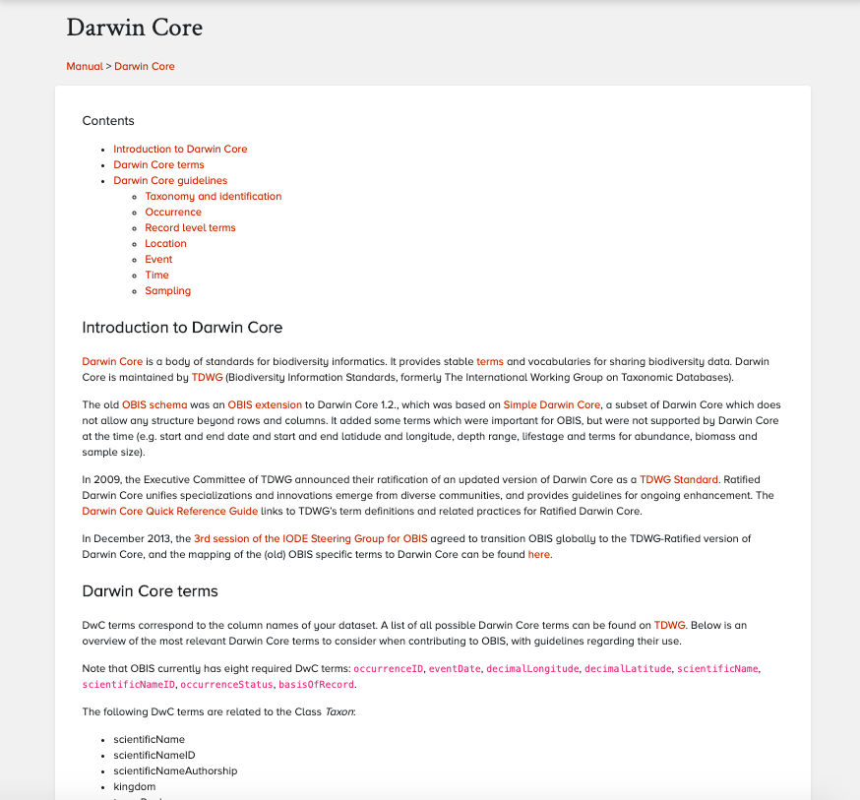
DATA standards
DATA
The Darwin Core is a body of standards. It includes a glossary of terms intended to facilitate the sharing of information
METADATA
Ecological Metadata Language (EML) is a metadata specification developed by the ecology discipline and for the ecology discipline.
Modularity, Detailed Structure, Compatibility, Strong Typing
Notes:
This includes the use of well established data standards and vocabularies for the data and associated metadata for each of the projects that make up the knowledge base of OBIS and its nodes. The internationally accepted body of standards for our sort of data is the Darwin Core, and the metadata specification that we use to describe things at a higher level is Ecological Metadata Language. These Darwin Core archives and associated EML files are the basis of a project within OBIS and the software that is used to push this information around and aggregate it sensibly. Darwin Core is a living standard, maintained by the folks at Biodiversity Information Standards (TDWG), and their meetings are lively and their community is responsive to extensions and changes to the way things are done. I’ve had a lot of success getting new ideas on how we are monitoring marine life into schemas and helping extend the accepted terms in DarwinCore to fit what we are coming up with next. As part of our time this week, we’ll build a few example DarwinCore Archive packages and try and vet them against the Integrated Publishing Toolkit that is released by GBIF and in use by both GBIF and OBIS to aggregate data. GBIF are concerned with all terrestrial life, not just the marine side of things, but their mission is very similar and indeed their data scope is a superset of OBIS’s. Data you aggregate to OBIS can show up on GBIF as well by toggling a setting, and we’ll go over how and why you might want to do that too.

Slide 10
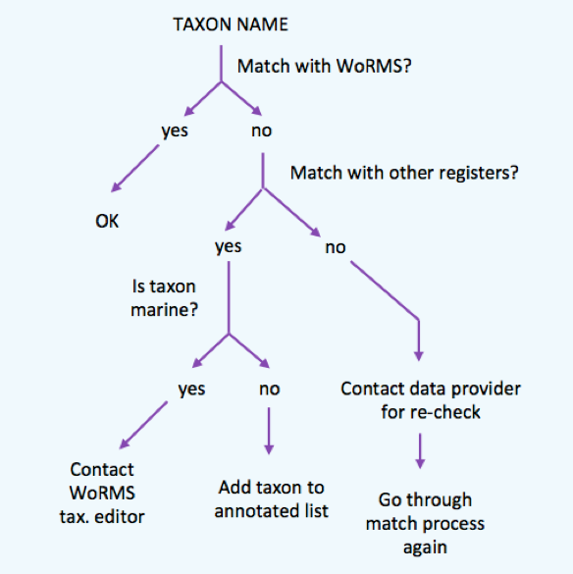
QA
Taxonomy
Geography
Depth
Completeness
Date & time
Presence, abundance & biomass
Data format
Required fields
Required values
Outliers
Environmental
Spatial
Quality Assurance makes sure you are doing the right things, the right way.
Quality Control makes sure the results of what you've done are what you expected.
QC
R OBIStools
Notes:
Data Management and Best Practices are a must for open-access, interoperability of data. Includes proper implementation of quality control and quality assurance processes.
So let’s define some terms here for the week, QA and QC. Quality assurance, you’re doing the right things, and in the right way. Quality control, verifying that the result of your process is what you expected it to be.
OBIS lets you verify many parameters of your data to check if they match up with reality. Are your taxonomic classifications accurate and up to date? does the observation describe a well-formed geographic location or shape, is the value of any provided depth variable possible at the given location, is the record complete in time and in number. Are all the required fields and values present, and are there any extreme outliers in this dataset? OBIS maintains an R package to help people work through their individual datasets and arrive at some of the answers to these questions before bringing it to aggregators like OTN and you folks here at OGSL, but I heard that you’re more comfortable in Python, and so are we. So while I want you to be aware of R’s obistools package when communicating about QA and QC with data providers and partners, we might want to instead show off how to use OBIS’s API to achieve some of these checks in our existing code bases. And that’s something we’ll work out together on the second and third day.

Slide 11
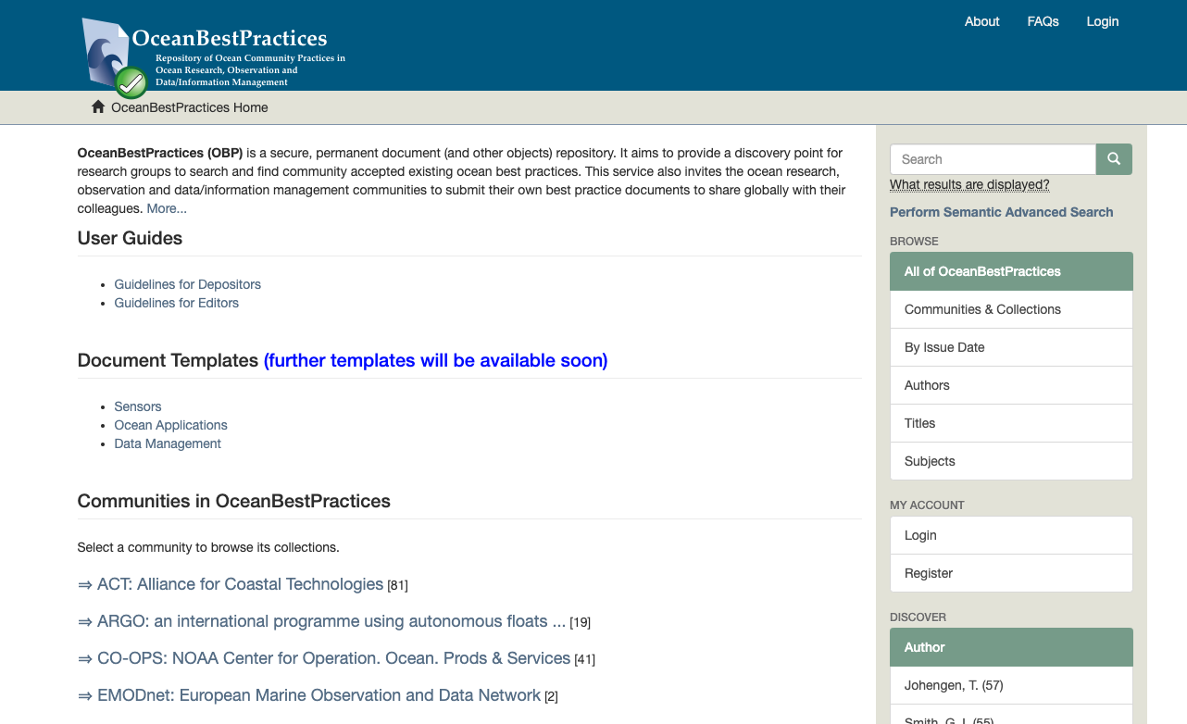
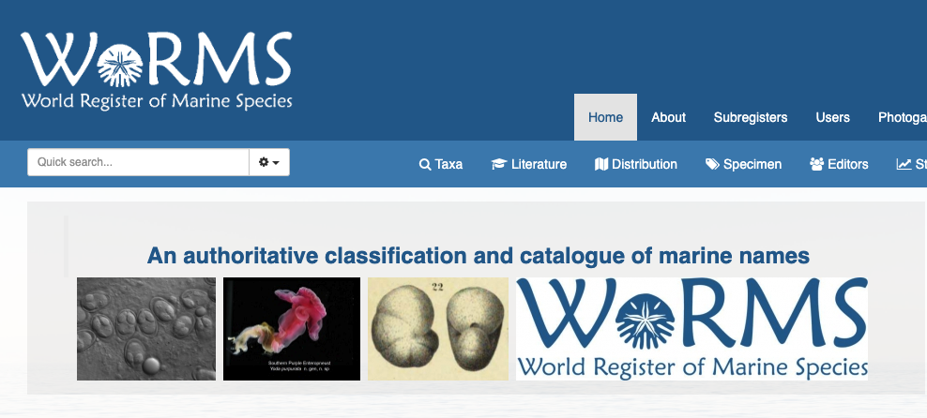
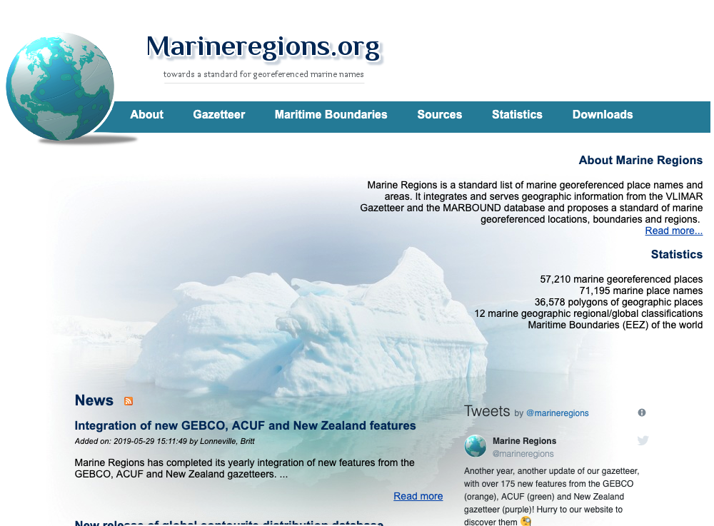
Ocean Best Practices
Notes:
Data Management and Best Practices are a must for open-access, interoperability of data.
Implementing Quality Control, Quality Assurance includes the use of vocabularies and gazetteers. Using a common set of vocabularies also greatly assists with data interoperability.
It’s important to follow best practices, but in a lot of these disciplines, best practices is a very new conversation, and almost all science is a continuing conversation about what the best practices are. OceanBestPractices (OBP) is a secure, permanent document (and other objects) repository. It aims to provide a discovery point for research groups to search and find community accepted existing ocean best practices. https://www.oceanbestpractices.net/ We’re authoring some resources in here about proper field deployment/maintenance and we intend to partner with the folks from Australia to co-author a compendium of how to quality control acoustic telemetry data. A wonderful resource for yourselves and for your data providers.
The aim of a World Register of Marine Species (WoRMS) is to provide an authoritative and comprehensive list of names of marine organisms, including information on synonymy. While the highest priority goes to valid names, other names in use are included so that this register can serve as a guide to interpret taxonomic literature. http://marinespecies.org The R tools that OBIS maintains provides checks against the WoRMS data system, but WoRMS also maintains a standalone API, and Brian will use that to walk you through verifying the taxonomy of the data you are provided.
Another tool that helps us in our quest for globally understood data is a globally accepted gazetteer that will define ocean region and other less precise ideas of location in an unambiguous way. Marineregions.org is a gazetteer that we’ve recently begun to implement to sanitize our human-readable ‘locality’ data and gives standard shapefiles that define ocean regions and smaller-scale named marine bodies.
Geographic Information Systems (GIS) are a great tool, however, a unique georeferenced standard of marine place names and areas was not available, hampering several marine geographic applications, for example the linking of these locations to databases to integrate data. The purpose of Marine Regions is therefore to create a standard, relational list of geographic names, coupled with information and maps of the geographic location of these features. http://www.marineregions.org

Slide 12
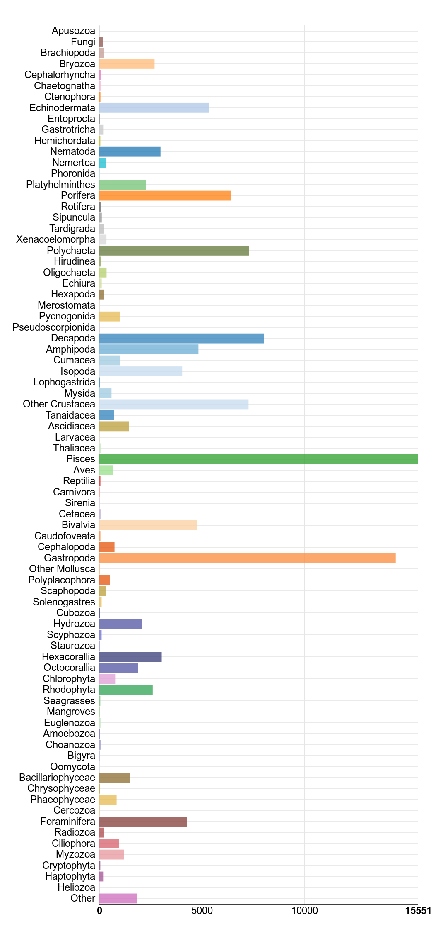
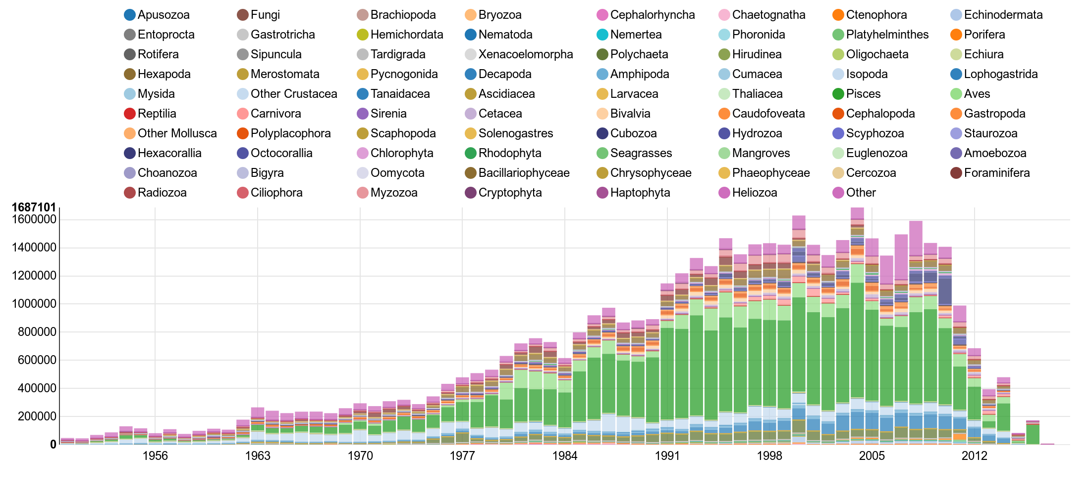
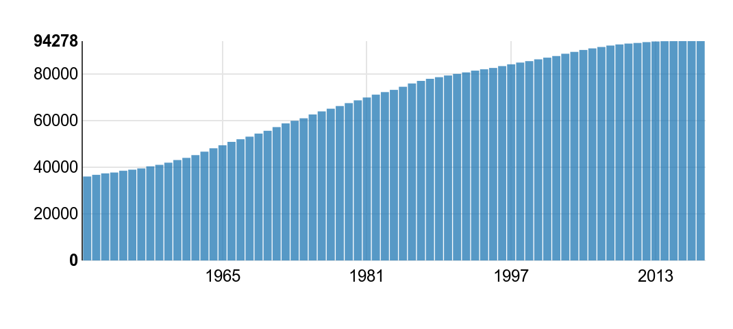
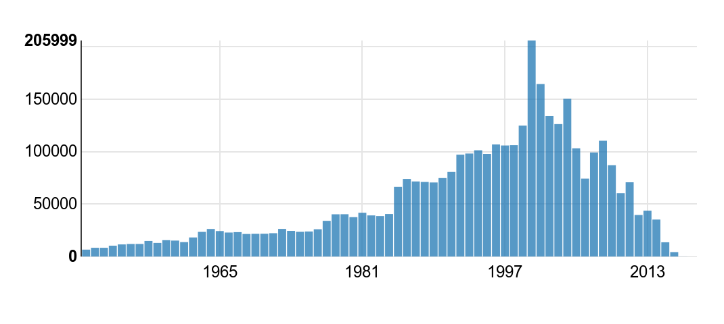
Species per Group
Records per Year
Species Accumulation
Sampling Events
Notes:
OBIS Stats
Taxonomically speaking, what’s in OBIS right now? Fish. Fish and snails, sometimes lobsters, some worms, some starfish. These aren’t all the way up to date, but it’s definitely humans who are doing the looking and recording, and the sampling events and species concerned reflect our own priorities. It could be that eDNA helps reverse this trend somewhat, broaden the species being identified, but there are a few dimensions of observation bias, and another one is:

Slide 13
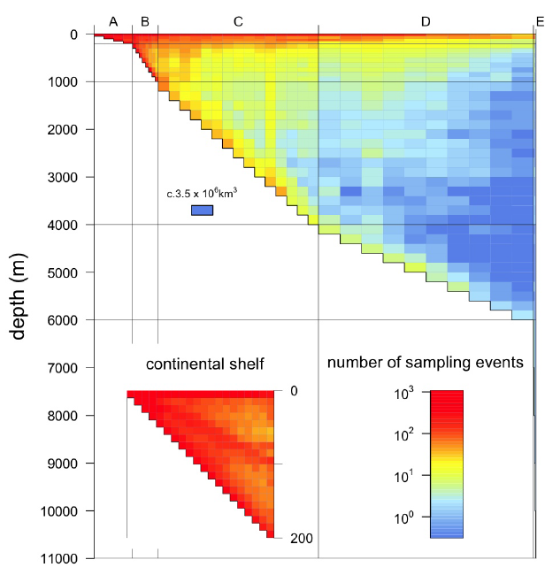
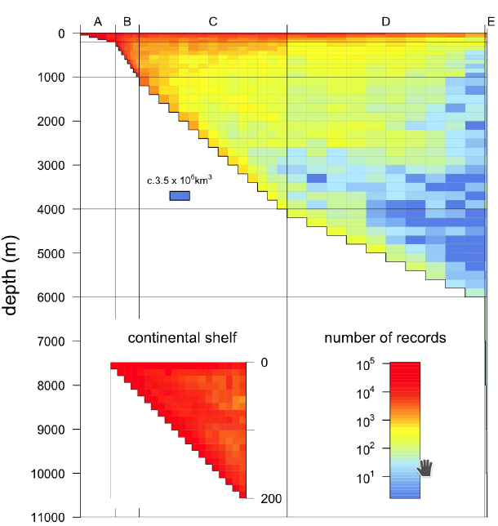
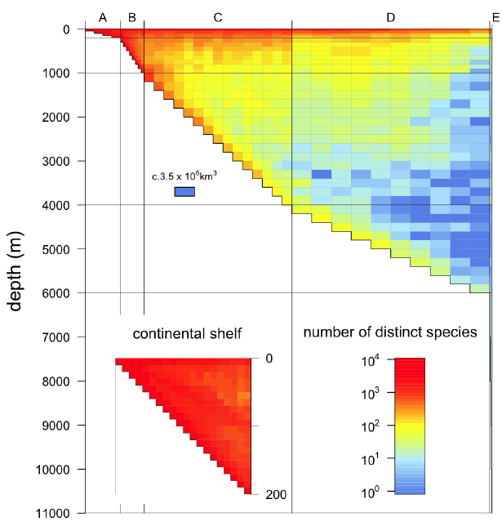
# Records
# Species
# Sampling Events
2/3 of our knowledge is in the upper layer (5% of the ocean)
UNESCO IOC and UNEP (2016). The Open Ocean: Status and Trends. United Nations Environment Programme (UNEP),Nairobi. D1 No.: 16-06580
.
Notes:
Access. The ocean’s hard to get to. The surface is easier than at-depth, and the shelf is easier than the open ocean. While this has been true for a long time, this is an area that technology is beginning to have an impact, with autonomous vehicles and remote sensing and bioprobes making it easier to follow animals and get a complete picture of their presence in and use of the ocean. One advantage to being heavily biased towards shelf and surface, is that it is generally where policy is made and enforced.

Slide 14
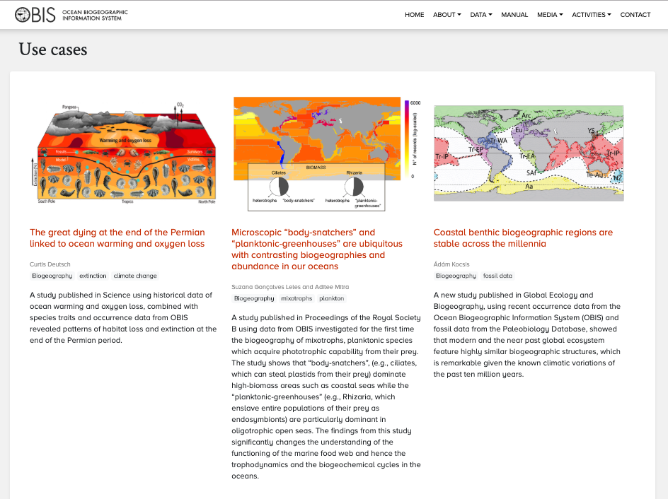
Example Use Cases
Notes:
You can explore some of the use cases for OBIS aggregated data sets on the OBIS portal, that’s obis.org. As data begins to cover greater spatial and temporal scales, broader patterns are observed and we can have more confidence in the patterns we see.

Slide 15
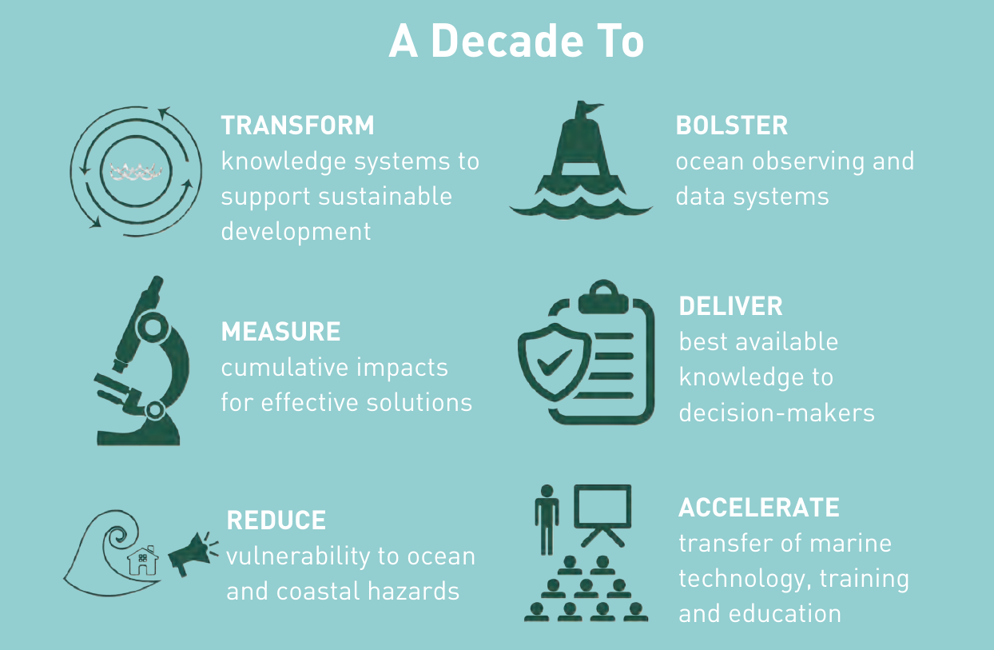
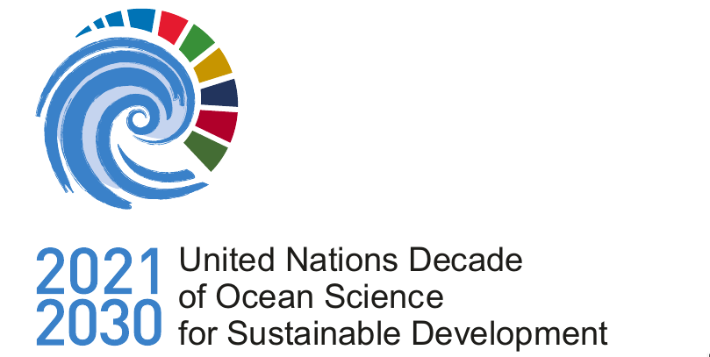
UN Decade of Ocean Science for SD
THE VISION:
To develop scientific knowledge, build infrastructure and foster partnerships for a sustainable and healthy ocean
Notes:
And as we’re about to embark on the UN decade of ocean science for sustainable development, finding these patterns and using them to build good policy will be a very important goal for us all, for OBIS, for the IOC, for UNESCO, for the world. OBIS can be a vehicle for us to add our efforts to a decade-long initiative to make our world smarter about how we use our oceans.

Slide 16
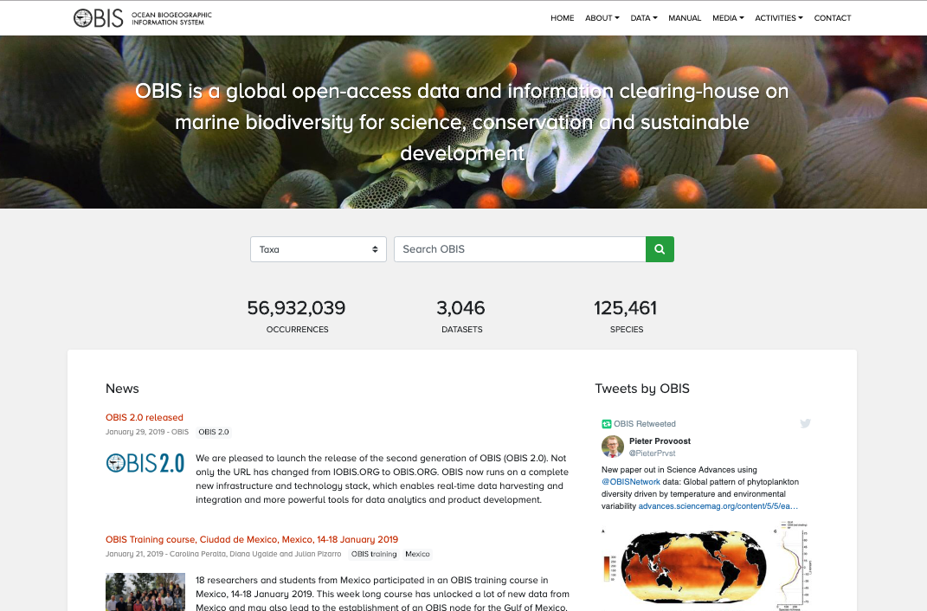

The OBIS
portal
https://obis.org
Notes:
the new OBIS portal is now 1 year old, launched last January, it’s a discovery mechanism for interested parties to find relevant data.

Slide 17
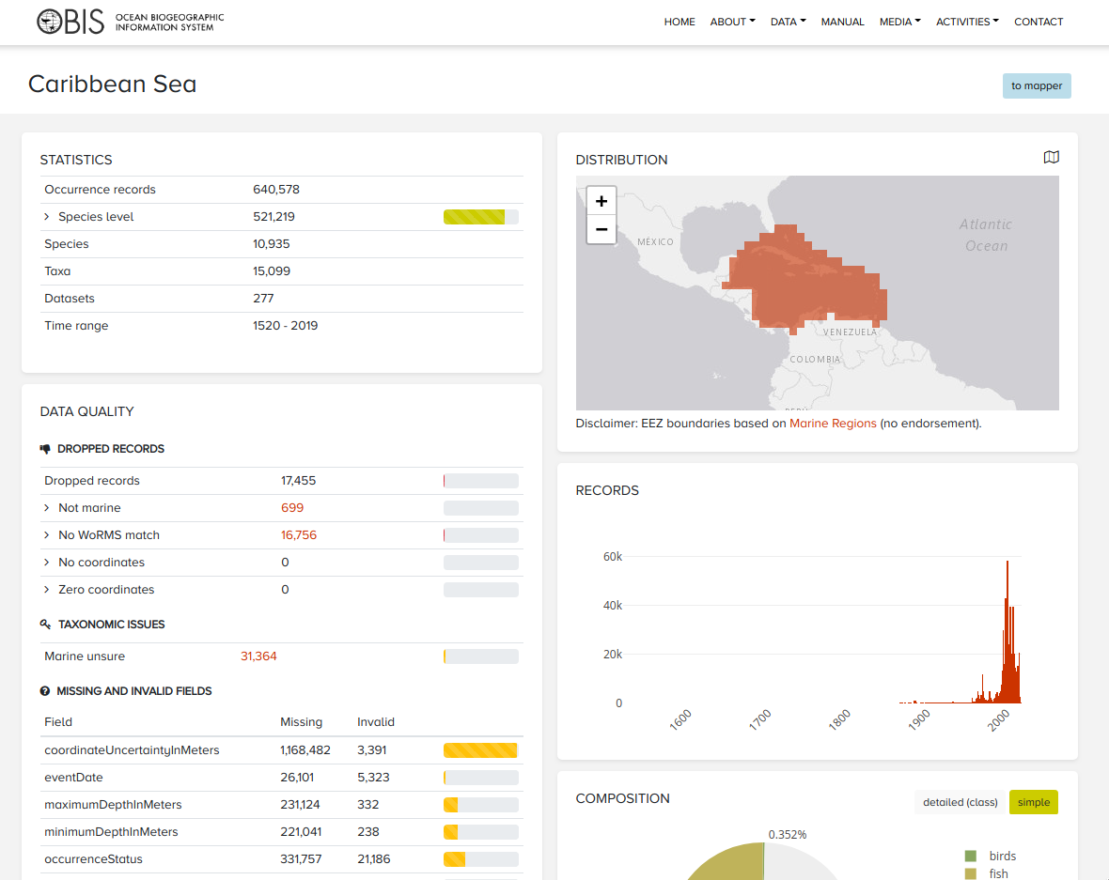
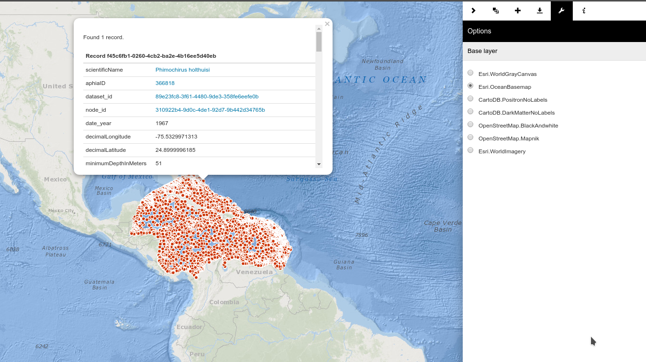
The OBIS
portal
https://obis.org
Notes:
You can search by region, by taxa, by provider, and there are some basic geospatial data visualization tools built in to make exploring and downloading the correct data easy.

Slide 18
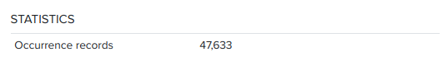
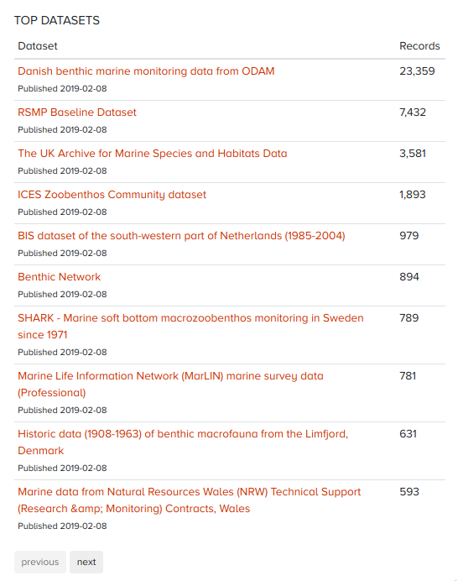
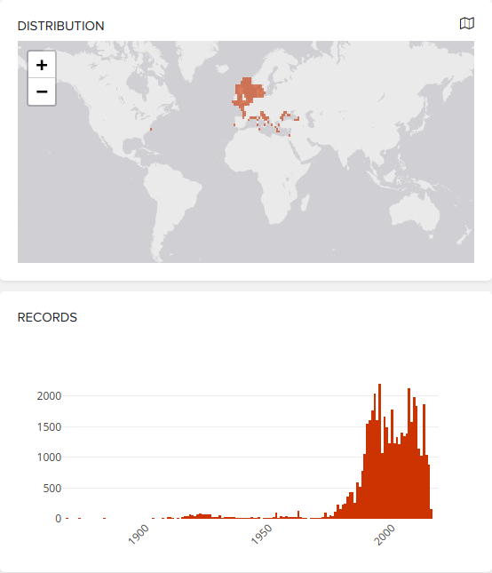
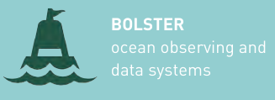
The OBIS
portal
Integrating Datasets
Implementing Standards
Developing open access tools
Promoting collaboration
104 datasets
Notes:
One cool thing about the portal sitting on top of all of our data, is that searching by taxon integrates all the species specific records from all of the datasets in OBIS

Slide 19
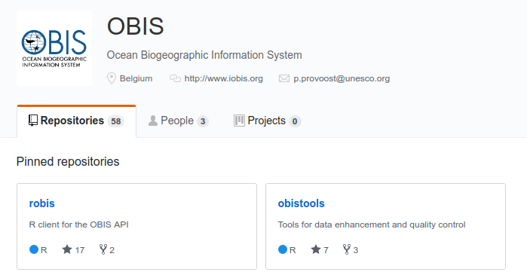


The OBIS
portal
OBIS
EVENT-CORE
schema
Integrating Datasets
Implementing Standards
Developing open access tools
Promoting collaboration
Notes:
The main way to lay out a DwC-A file for a long time was with a square matrix of animal occurrences, with the fields mapped to DarwinCore terms, called Occurrence Core.
Recently, though, OBIS has developed a Darwin core extended OBIS EVENT-CORE, permitting additional measurements of fact, ex. Cruise info; physical/chemical oceanographic variables; This can have many advantages when passing data on to an end user, the structure of the event data can describe sampling effort and other parameters of the project that are not necessarily occurrence-oriented.
This extension has a good degree of subjectivity over how you might implement it for various projects, there’s a paper from 2016 by Daphnis De Pooter that Naomi will refer to, which sets out six different ways you might map your project’s sampling strategy into Event Core. We in the biologging realm found these six methods to still not quite capture what we wanted to capture, so we are in the process of finding a schema for Event Core that will work for biologging data. That stuff’s on GitHub under tdwg/dwc-for-biologging
Also on GitHub, OBIS provides a R client library for their OBIS API, they are responsive via Github issues reporting for both this ROBIS tool and their general obis data analysis toolbox, called obistools.
There are community-led Python libraries that replicate some of this functionality but they’re not as well maintained so we can’t speak to their usefulness. OTN’s found it more reliable to interface directly with the APIs for OBIS and WoRMS for the time being.

Slide 20
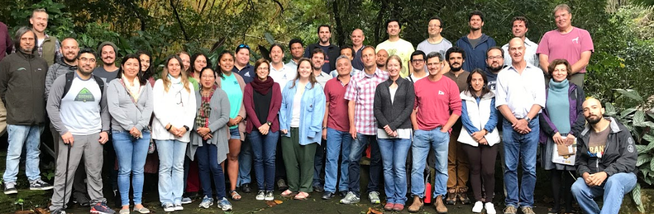
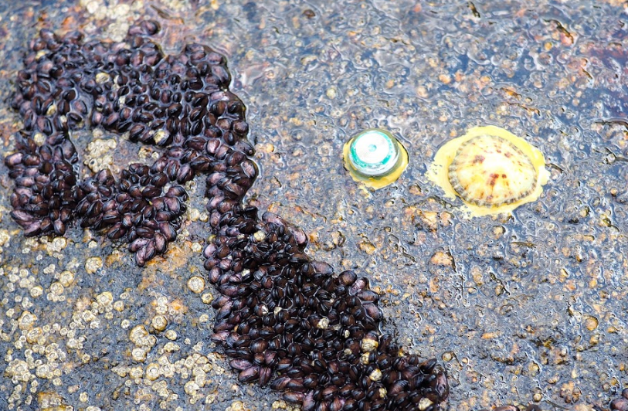
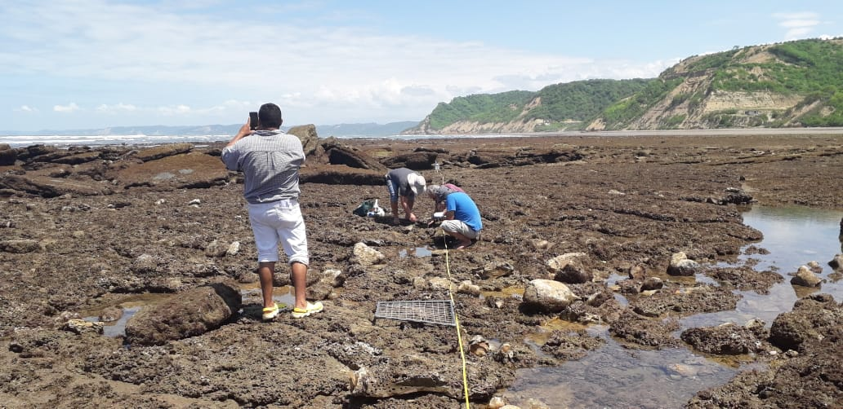
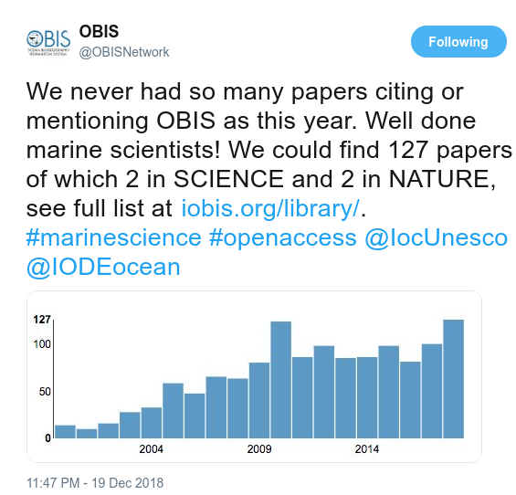
MBON Pole to Pole of the Americas
Integrating Datasets
Implementing Standards
Developing open access tools
Promoting collaboration
Notes:
Partership in OBIS opens up many avenues and initiatives, some important ones for Canada especially are the Group on Earth Observations Biodiversity Observation Network and its Marine Biodiversity Observation Network initiative, MBON has a Pole-to-Pole of the Americas programme headed up by Gabrielle Canonico that is partnering with biodiversity data collectors from the arctic through to the southern ocean to map biodiversity across a broad range of taxonomy. OBIS and Darwin Core provides a useful standard to arrive at in order to contribute to this and other initiatives.

Slide 21








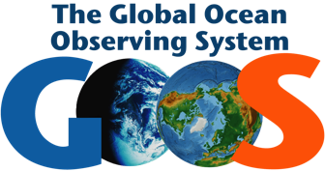
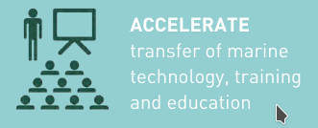
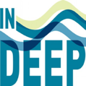
Supporting International Processes
UN
World
Ocean
Assessment
Assessment
EBSA
Indicators
VME
EBV
MBONs
Bon in a Box
eEOV
Deepsea
GOOS OBS
Notes:
So the overarching message here is that OBIS is an internationally-backed team of data professionals looking to aggregate and serve many of the world’s sustainability initiatives with a unique and comprehensive data system on marine animal presence built from the consensus and aggregation of all of our efforts as data creators and aggregators around the world. Its data can be relied on as a quality controlled source for essential ocean variables, essential biodiversity variables, ecological health indicators, parameters for species abundance and population health assessments,

Slide 22
Final Remarks
Many opportunities
New technologies
Emerging partnerships
Mandates from multilateral organizations
EOV framework
Notes:
So that’s the why of OBIS. Collaborating and conforming to this data standard gives you and your data providers a bunch of opportunities to build partnerships with groups around the world who are doing similar studies, displays your ability to put contributors’ data where multinational and intergovernmental organizations will be relying on it, and thus it gives your data the opportunity to directly contribute to the global understanding of ecosystem health via Essential Ocean Variables.

Slide 23
Final Remarks
Many challenges
Delay in data availability
New data types, technologies
Taxonomic, temporal and geographical gaps
Multi-partnership engagements
Many clients, different interests
Notes:
There are a few necessary caveats of course, as we’ll see tomorrow, the global data aggregation system doesn’t have a good handle on ‘real-time’ data dissemination, so there’s a delay in data you publish being part of the global whole, and it takes work by everyone to integrate each new data type and technology, as we’re doing with biologging now.
There are and will remain taxonomic, temporal, and geographical gaps in data as we are far better at discovery and reporting on what’s happening in the places where we are as humans. This is both a bug and a feature, though, for decision making.
And it is always the case that of your many clients and data providers, some may not see a benefit to publishing data, especially to the world. This is especially true of biological data, but you will have to maintain an idea of what your data providers’ interests are in sharing data up to global data systems like this one.

Slide 24
Take Home Message
Help promote the concept of data sharing!
Make research data accessible for reuse
Share scripts written for data analysis
Share stories and use cases
Provide feedback
What is your role?
Notes:
So, if you’re sold on OBIS being a good thing, some of the ways you help the cause are exactly the things I’m sure you’re doing now. Promoting the concept of data sharing to your clients and your colleagues, making research data available, sharing scripts for analysis and formatting, and stories and use cases for certain approaches and data types. OBIS, and as we’ll soon talk about, WoRMS, thrives on feedback, so when you’re making archives and publishing them, they have an open and responsive group ready to help meet the needs you identify. OBIS-Canada is definitely in need of more

Slide 25
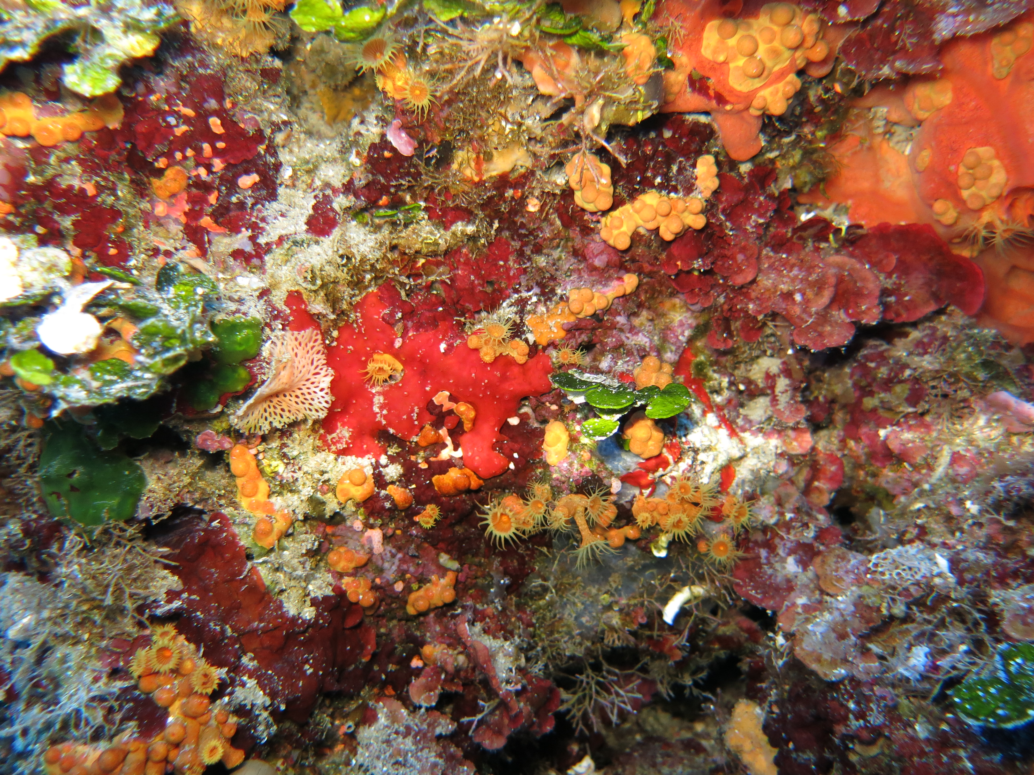
Final Remarks
Marine Biodiversity Data is Ocean Data!
Photo credit: Lizandro Benedetti-Cecchi

Slide 26
OBIS Training - Jan 2020
Jon Pye, Brian Jones, Naomi Tress
Ocean Tracking Network Data Centre

Slide 27

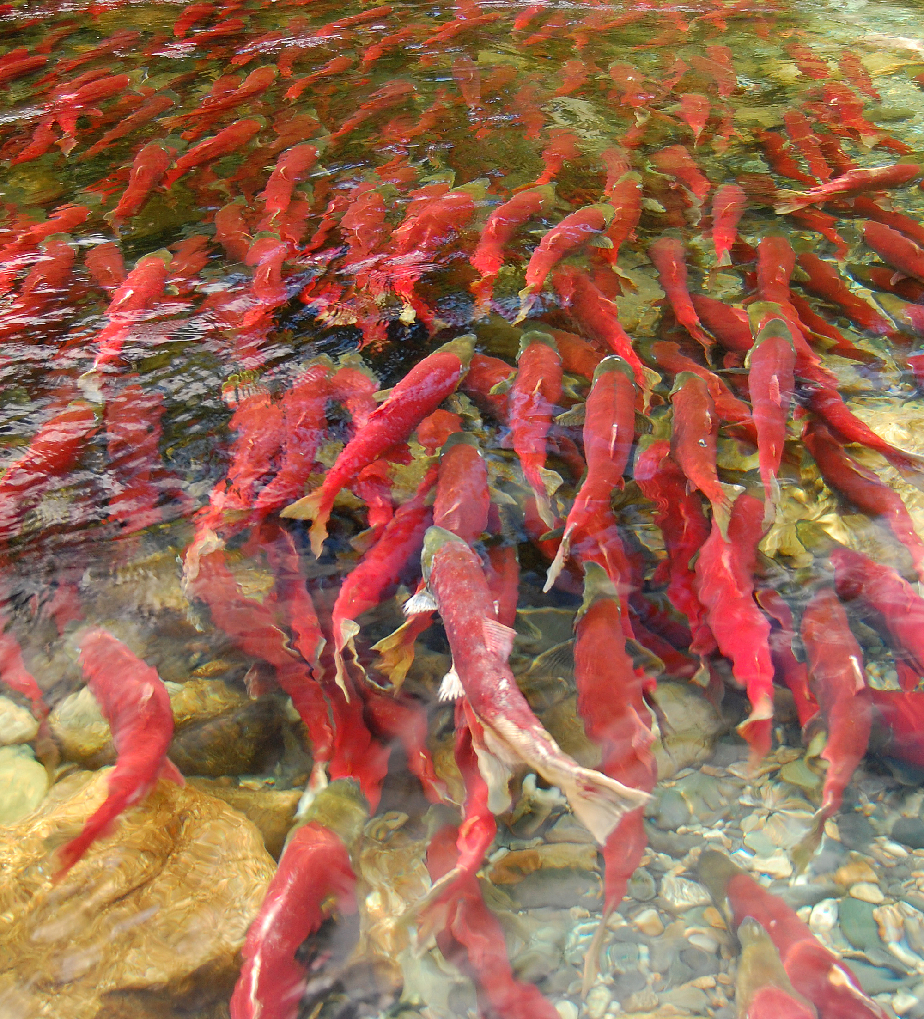
Workshop Schedule
Day 1
Intro to OBIS , [you are here!], WoRMS
Darwin Core terms and record types
OBIS Data and Metadata Formats (EML, DwC)
Data processing, taxon matching QC
Data aggregation via OBIS Nodes – IOC data policy
Registering datasets with OBIS IPTs
Hands-on session – mapping OGSL schema to DwC terms, mapping metadata and data in ogsl.ca/biodiversite to DwC Occurrence or Event Core
Day 2
OCEAN TRACKING NETWORK
Notes:
So here’s the workshop schedule for the next few days. We’re giving you the run of what OBIS is and why it’s great, next I’ll talk to you about the first of the quality control resources that OBIS helps make available to you, then we’ll go over how Darwin Core terminology works, where to find help with it, and the different ways you can assemble a Darwin Core archive. Hopefully by then it’s lunchtime, and we can talk about how those Darwin Core archives become OBIS datasets and what the format for OBIS dataset metadata is. We’ll then work together to sketch out how you might do some data processing and taxon matching and quality control using all the tools above in your existing data ingestion workflow.
Tomorrow, we’ll talk about how OBIS aggregates data from its member nodes into the international data system, what IOC’s data policy means, and more about the EML format for the project level metadata and how that’s accepted by the OBIS IPT. We can go over how to register datasets with an OBIS IPT both by hand and using some of the API-backed tools that Brian has written some demos for. That’s all the instruction that I think you’ll find relevant to your situation, so from there on we’re going to do some hands-on sessions. We’ll look at an example of an OGSL biodiversite dataset and how it maps to Darwin core terms, map the metadata and data to Occurrence core, which is pretty easy, and then we’ll take on Event Core together, which is harder and more subjective.

Slide 28
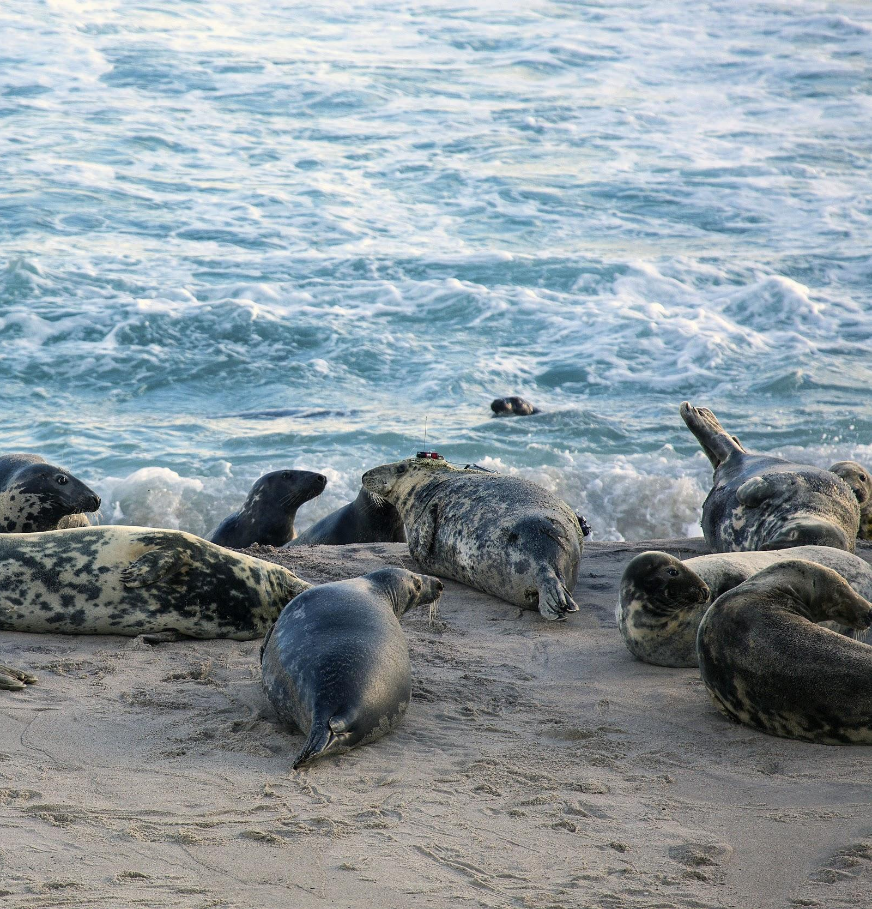
Workshop Schedule
Day 3
Hands-on session 2: workshop-directed project kickstart
Potential project Ideas:
Design data pipeline, MVP of OBIS-compliant archive generator for ogsl.ca/biodiversite
Deploy a test-mode IPT on ogsl.ca infrastructure to verify and publish DwC archives for biodiversity projects
Design and publish a Python package to replicate the API wrappers available in the obis R packages
Ideas welcome!
OCEAN TRACKING NETWORK
Notes:
The final day, we’ll take our experience and work out how we might implement something that will last a bit longer-term here at OGSL. We’ll decide what form that takes together, but some ideas I had were, designing a data pipeline that produces, from your current data workflows, an OBIS compliant archive for a given biodiversity project held here at OGSL. We could alternatively (or we can do multiple groups if there’s a few things we want to tackle) put up a test-mode IPT service so that you can verify and publish DwC archives yourselves. We could also help bridge the gap between Python and R users of OBIS and rescue pyobis, or design ourselves a replacement that will give people access to the OBIS and WoRMS APIs in the way that they are used to seeing in the R packages that OBIS offers. If there’s a project idea you have at the end of the instruction period, we can get a start on scoping it on day 3, and see how far we can get started with it.

Slide 29
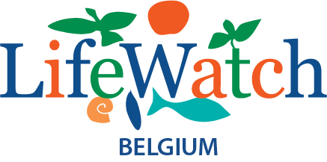

Introduction to WoRMS,
the World Register of Marine Species
Notes:
So the walkthrough of the WoRMS system was prepared by the inimitable Leen Vandepitte, I’ll do my best to hit all the same important points.

Slide 30


WoRMS in a nutshell
WoRMS aims to provide the most authoritative list of names of all marine species globally, ever published
Not just a name-index, but expert-based taxonomic database
>400 taxonomic editors
Elected Steering Committee (SC) (12+1 members)
Data management team
Permanent host institute: VLIZ => “here to stay”
Web-based system, including web-services
International standards
Background
2004: MarBEF EU FP6 => online European Register of Marine Species - ERMS
2007: further development to World Register
Notes:
So the world register of Marine Species aims to be an authoritative lookup engine for all marine species ever published, globally. It relies on human expertise to curate the living, changing taxonomic classification system. Their steering committee is composed of a broad geographic and taxonomic cross-section of research data management professionals, and their data management team at VLIZ is strongly backed by that institution. I remember a time when you could only use their SOAP web service, but now they have a wonderful REST API that we’ll explore later on. They began as the European Register of Marine Species, and they expanded to become the World Register in 2007.

Slide 31
Aphia platform
Databases hosted at VLIZ
WoRMS
Polychaeta
Porifera
HAB
WRIMS
...
AfReMaS
CaRMS
...
WoRDSS
Cetacea
Hydrozoa
...
Thematic species databases
IRMNG*
Mollusca
Base
Isopoda
RAMS
ERMS
...
Regional species databases
FreshGen
Compositae
Global species databases
FishBase
AlgaeBase
...
Externally hosted
and managed
species databases
Turbellaria
Reptiles
Vandepitte et al., 2015
Notes:
Figure 2: WoRMS in the Aphia Platform and its component taxonomic databasesLeen wrote a paper on how the Aphia platform helps both the taxonomists who build it and the biodiversity informatics folks who leverage it in the way we’re about to see.
There are many databases that feed into the same Aphia platform. These data systems have different scopes, the blue ones are focused on the marine environment, the orange ones span all environments, marine/fresh/terrestrial, the yellow is a species database just for freshwater, and the green which is still a bit blue on this graph is a focus on terrestrial only.
Blue: species database with focus on marine environment;
Orange: species database dealing with all environments (marine-fresh-terrestrial);
Yellow: species database with focus on freswhater environment;
Green: species database with focus on terrestrial environment.
WoRMS: World Register of Marine Species;
IRMNG: Interim Register for Marine and Non-marine Genera;
AfReMaS: African Register of Marine Species;
CaRMS: Canadian Register of Marine Species;
RAMS: Register of Antarctic Marine Species;
ERMS: European Register of Marine Species;
HAB: IOC-UNESCO Taxonomic Reference List of Harmful Micro Algae;
WRIMS: World Register of Introduced Marine Species;
WoRDSS: World Register of Deep-Sea Species.
*: IRMNG is focused on genera, not species.

Slide 32
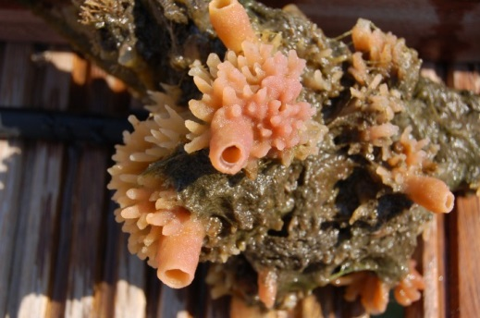

Databases hosted at VLIZ
Aphia
Haliclona (Soestella) xena
Introduced
WoRMS
HAB
Mollusca
Base
...
WoRDSS
Thematic species databases
Porifera
Polychaeta
CaRMS
Cetacea
...
AfReMaS
Hydrozoa
ERMS
Global species databases
RAMS
...
Regional species databases
WoRMS structure
An example…
Notes:
So in this representation, you can see that via a species’ AphiaID, you can find it in the global species databases that are appropriate, as well as the regional and thematic data systems, it goes into the Aphia database once, and based on its characteristics, it gets contexts in all the relevant data systems. This is a european invasive marine sponge species, and you can find it in the Worms database, the European register of marine species, in the IOC HAB data system under their subsection on foreign introduced species, and the global species-based database it belongs to, Porifera.
Identical to previous slide, but with an example to illustrate the fact that a name only gets added once into the Aphia database and – based on its characteristics: taxonomical, geographical or other – it gets a specific context (or contexts) and can be shown in several of the available species registers.
Haliclona (Soestella) xena De Weerdt, 1986 => marine sponge species, alien & european

Slide 33
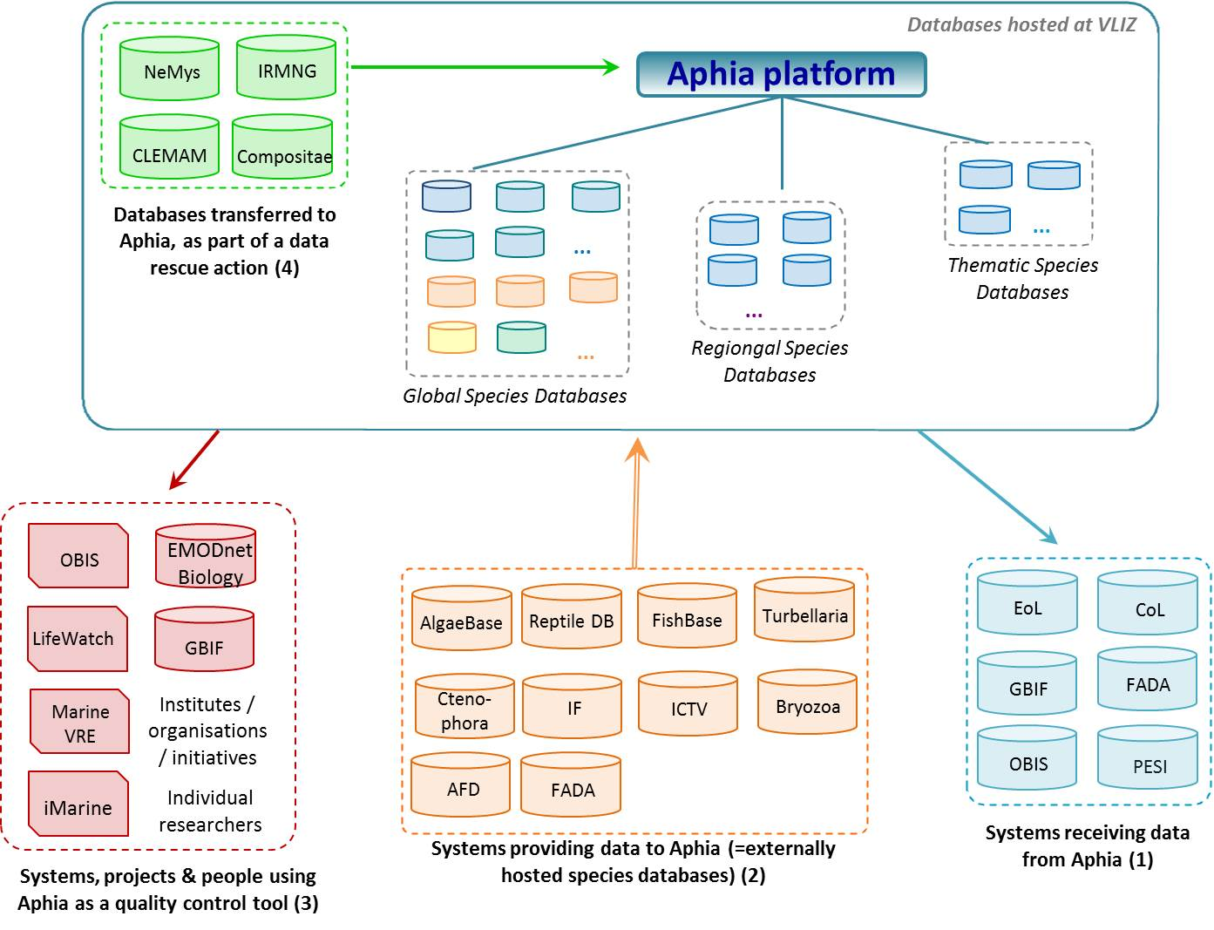
Relationship of Aphia with other systems & projects
Source: Vandepitte et al. (2015). How Aphia – the platform behind several online and taxonomically oriented databases – can serve both the taxonomic community and the field of biodiversity informatics. JMSE.
Notes:
There are a few ways Aphia relates to other data systems, and they fall into four broad categories can be identified:
Aphia as a data supplier to other systems,
Aphia as an integrator of relevant data from other systems,
Aphia as a quality control tool for the (taxonomic) content of other systems, projects and initiatives or
Aphia as an infrastructure to host and rescue databases at the risk of being lost.
NeMys: World List of Free-living Marine Nematodes;
IRMNG: Interim Register for Marine & Non-marine Genera;
CLEMAM: Checklist of European Marine Molluscs;
Compositae: Global Compositae Checklist;
OBIS: Ocean Biogeographic Information System;
EurOBIS: European node of OBIS;
Marine VRE: Marine Virtual Research Environment;
GBIF: Global Biodiversity Information Facility;
Turbellaria: Turbellarian Taxonomic Database;
Ctenophora: Phylum Ctenophora: list of all valid species names;
IF: Index Fungorum;
ICTV: International Committee on Taxonomy of Viruses;
Bryozoa: Recent & Fossil Bryozoa;
AFD: Australian Faunal Directory;
FADA: Freshwater Animal Diversity Assessment;
EoL: Encyclopedia of Life;
CoL: Catalogue of Life;
PESI: Pan-European Species directories Infrastructure;
OToL: Open Tree of Life.

Slide 34
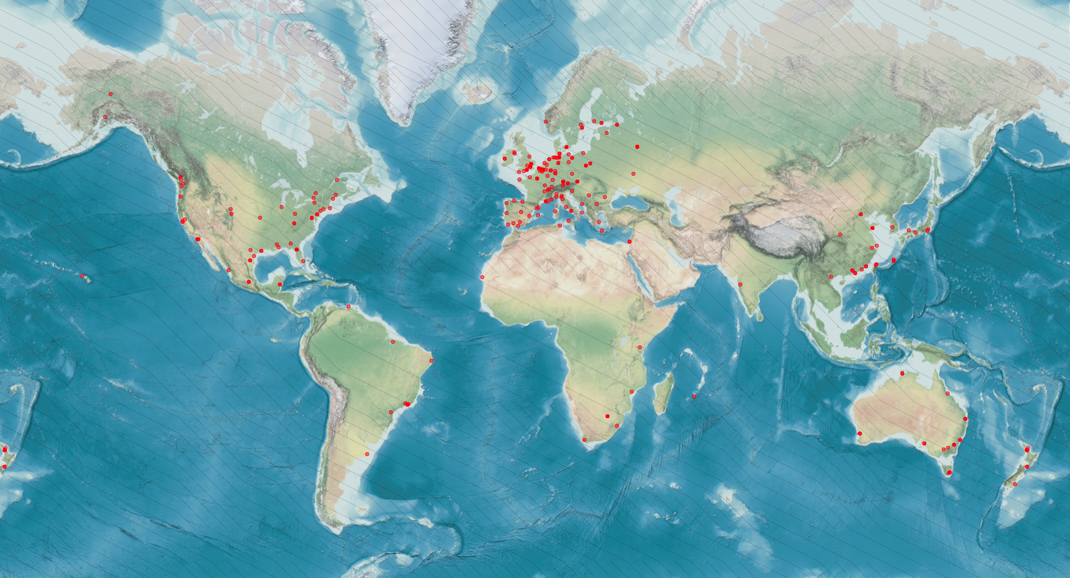
WoRMS – supported by a large editorial network
Taxonomic & thematic editors
> 400 people > 40 countries > 190 institutes
Notes:
WoRMS has a great international reach, supported by over 400 taxonomic experts across 40 countries and 190 institutes, including Claude Nozères over at the Maurice Lamontagne Institute, who’s been affiliated with CaRMS for a long while now.
An updated map can be retrieved from http://www.marinespecies.org/map.php?type=te

Slide 35
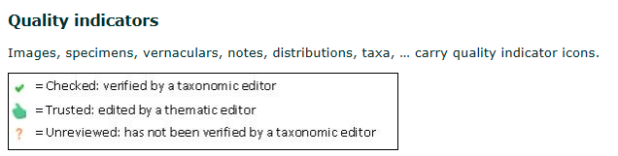
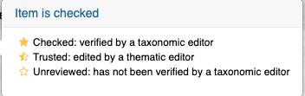
WoRMS management
Different levels…
WoRMS Steering Committee
WoRMS editors
Taxonomic editors
Thematic editors
Data management team
Editorial actions :
“checked” (from editor or global species database)
“Trusted” (from regional or thematic species database)
“unreviewed” (from other sources)
Notes:
So from Steering Committee to editors to the data management team that handles the availability and reliability of the data itself, there’s a lot of pieces that go into making sure the data we ask WoRMS for comes back to us in a way we can use it. Editors can attach quality indicators to images, specimens, vernaculars, even whole taxonomic entries. So when you see it’s checked, that means an editor has seen it and verified it. Trusted means a thematic editor, someone who specializes in this family or this taxa, has approved it, and if nobody’s reviewed it yet to sign off on it being 100% accurate, you will see Unreviewed. A submission was still made, meaning someone cared enough to add it, and almost always that meand they provided literature to back up their claim, but the editors haven’t looked it over yet.

Slide 36
WoRMS – content for a single entry
Aphia: a lot more than just taxon names & their relationship…
Feeding type
Host-parasite relations
Body size
Fossil range
Skeleton (calcareous or not)
Taxonomy
Distribution
Attributes
Specimen
Sources
Aphia
Vernacular names
Identification keys
Notes
Links
Images
Internal database management
Notes:
So there’s a lot more than just taxonomic names in WoRMS, you get regional vernaculars in many different languages, you get distribution data if such data has been submitted and verified, you get images if they’ve been submitted, you get other weirder attributes like host-parasite relationships and what sort of skeleton these creatures have. A lot of optionally-populated fields that can help you or more likely your data providers get a good verification regime going.

Slide 37
WoRMS – content for a single entry
Minimal
Species name - authority & publication year - higher classification
Environment
Status (recent – fossil – recent & fossil)
Highly desired
Basionym
Reference of original publication
Holotype information (type locality, museum collection, number …)
Optional
Additional syonyms, references, images, morphological description, distribution, ecological information (feeding type, host-parasite relation …), web links & pdfs
Notes:
At minimum, you can be assured you’ll find a species name, the year it was coined, the publication associated with its naming, and the classification tree. You’ll know which environments it can be found in, marine, brackish, freshwater, and you’ll get a status. WoRMS encourages people to provide a basionym, which I’m not afraid to say I had to look up the meaning of, it’s the original name on which the new name for a species is based. So you can trace the history of a species’ classification using the basionyms. a reference to the original naming publication, and a visual representation, images, ilustrations, classification sheets, etc.
And as we’ve seen, there’s a whole laundry list of other things they can and will accept about a species. Morphological description can be very useful for QC, the size ranges and weight ranges for different sex and lifestages of species is very handy information for people at OTN to have, for example.

Slide 38
WoRMS – where are we? Some number crunching…
Taxonomy:
242,753 accepted marine species; of which 93% is checked
478,236 species names including synonyms (marine & Recent)
30,908 species with an image; of which 55% is checked
1,873 citations or references to WoRMS in literature
Still a number of (historical) gaps to fill => work in progress
Increment of 1,500 - 2,000 newly described species per year
> 30,000 non-marine species (accepted + synonyms)
E.g. Mollusca, Isopoda, Plantae, Chromista
Usage:
± 90,000 unique visitors per month
± 3 million hits per month
>150 registered users of our web services
> 80 institutes/organisations receive access to download a monthly copy of WoRMS

Slide 39
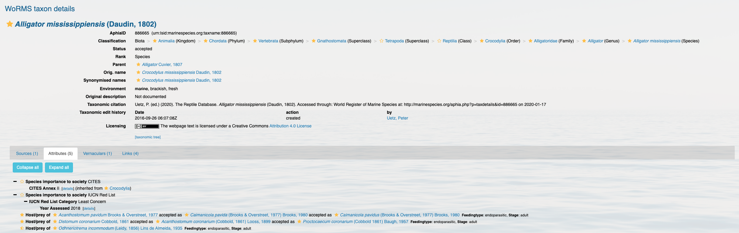
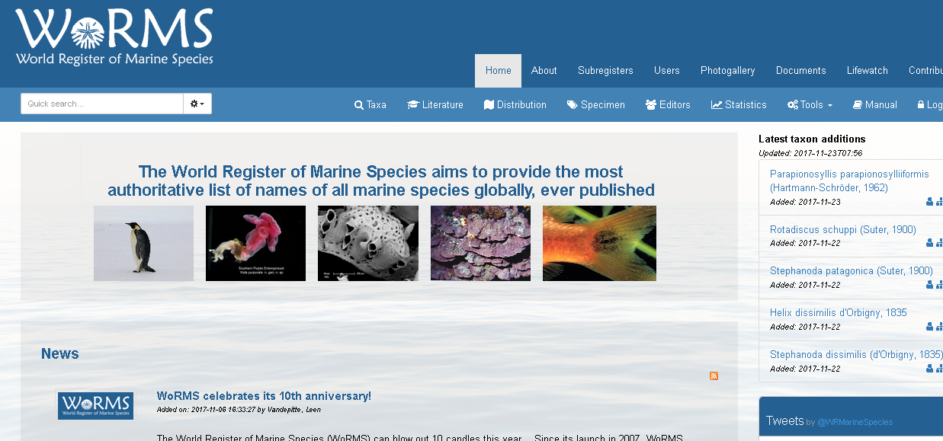
Online interface https://marinespecies.org
Notes:
So here’s what a species result page looks like on their web-front, this is for something I bugged them to add back in 2016, when they were still considering whether they wanted to incorporate freshwater species. Its got fully confirmed taxonomic information, it’s got the history of its classification and synonyms, there are some attributes provided where you have host/prey species, two of these are checked/confirmed, and one of them is merely Trusted.
The result we get back from the WoRMS API will have verification statuses for a lot of these attributes and we can decide whether we want to be particular about what level of verification we require. For name verification, we don’t have to do much, but your application can differ.

Slide 40
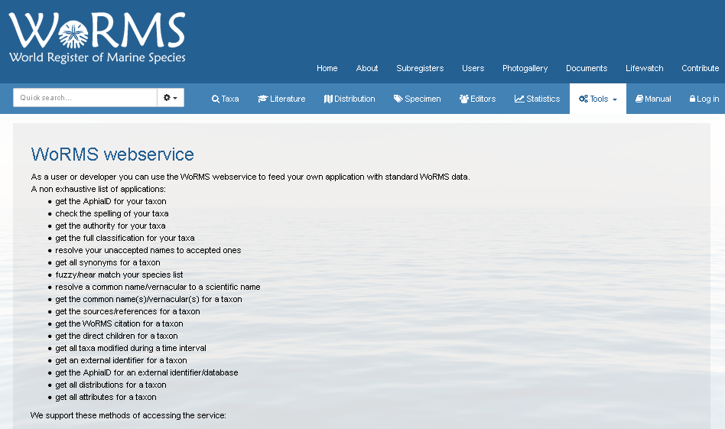
Web services: https://marinespecies.org/aphia.php?p=webservice
Notes:
And if you go to the Tools part of the WoRMS website you’ll see the various service endpoints they support. I’m proud/ashamed to say that my example implementation of how to use the SOAP service is still listed there, though I didn’t get to write the actual instructions for deploying it, I just gave them a file called worms.py that had functions with SOAP-py and SUDS implementations, and they wrapped it in command-line arguments and put it on there. Since then they’ve had a REST API stood up and we recommend going with that one. We’ll work with it later on to verify submitted taxonomic data.

Slide 41
WoRMS – part of LifeWatch
LifeWatch is part of the European Strategy Forum on Research Infrastructures (ESFRI)
LifeWatch = virtual laboratory for biodiversity research:
Biodiversity observatories, databases, web services and modelling tools
Integration of existing systems, upgrades, new systems
Construction phase: 2012 – 2016
Financed by Member States
Development of regional and central components by participating countries
Building a taxonomic backbone (focus on aquatic environment)
Building a Marine Virtual Research Environment (Marine VRE)
Start with “light” version => can become full grown infrastructure, conform reference model envisaged under LifeWatch
Based on existing data resources, web services, analysis services & tools
Notes:
Bottom-up development demonstrating possibilities
Construction of light version that can grow towards a full grown infrastructure conform reference model envisaged under LW
Building marine virtual research environment based on existing data resources, web services, analysis services and tools.

Slide 42


WoRMS – supported by LifeWatch
Taxonomic backbone
Facilitates the standardisation of species data
(Virtually) brings together different component databases & data systems
5 major components
SPECIES REGISTERS
Coordination:
Bring together existing databases; map their relationships; build web services
Complete & update taxonomic & species-related data
Data grants for editors
Data Management Team support
Technical developments
Organize & mobilize taxonomic experts
Organize workshops
Support meetings
Global
Thematic
Regional
National
LifeWatch Taxonomic Backbone
SPECIES OCCURENCES
LITERATURE
Global
Thematic
Regional
National
ECOLOGY (traits)
GENETICS
Notes:
The LifeWatch Taxonomic Backbone (TB) facilitates the standardisation of species data and the (virtual) integration of the many distributed biodiversity data repositories and operating facilities.
The TB (virtually) brings together different component databases and data systems, dealing with 5 major components:
Taxonomy: regional, national, European, global and thematic species registers
Biogeography: databases dealing with species occurrences
Ecology: species-specific traits
Genetics
Literature: links to available literature and tools to intelligently search this literature
The first level aims at setting up a central taxonomic backbone by integrating the existing taxonomic, biogeographical, ecological, genomic and literature databases as contributing components and build access services bringing the data to the LifeWatch infrastructure.
The second level aims at completing and updating the taxonomic and species related data in the different component databases by supporting these communities with a central data management task force, which is providing technical, logistic and financial support for upgrading and expanding the component databases. An example are the LifeWatch data grants (link is external) that were written out to fill the gaps in information in the World Register of Marine Species (WoRMS).
The third level aims at organizing and mobilizing the taxonomic experts that provide the data by supporting the taxonomy societies in which they participate (e.g. TDWG (link is external), PESI (link is external), EDIT (link is external) and MARBEF+ (link is external)). LifeWatch will provide logistic and financial support for workshops and meetings with and between the societies.

Slide 43
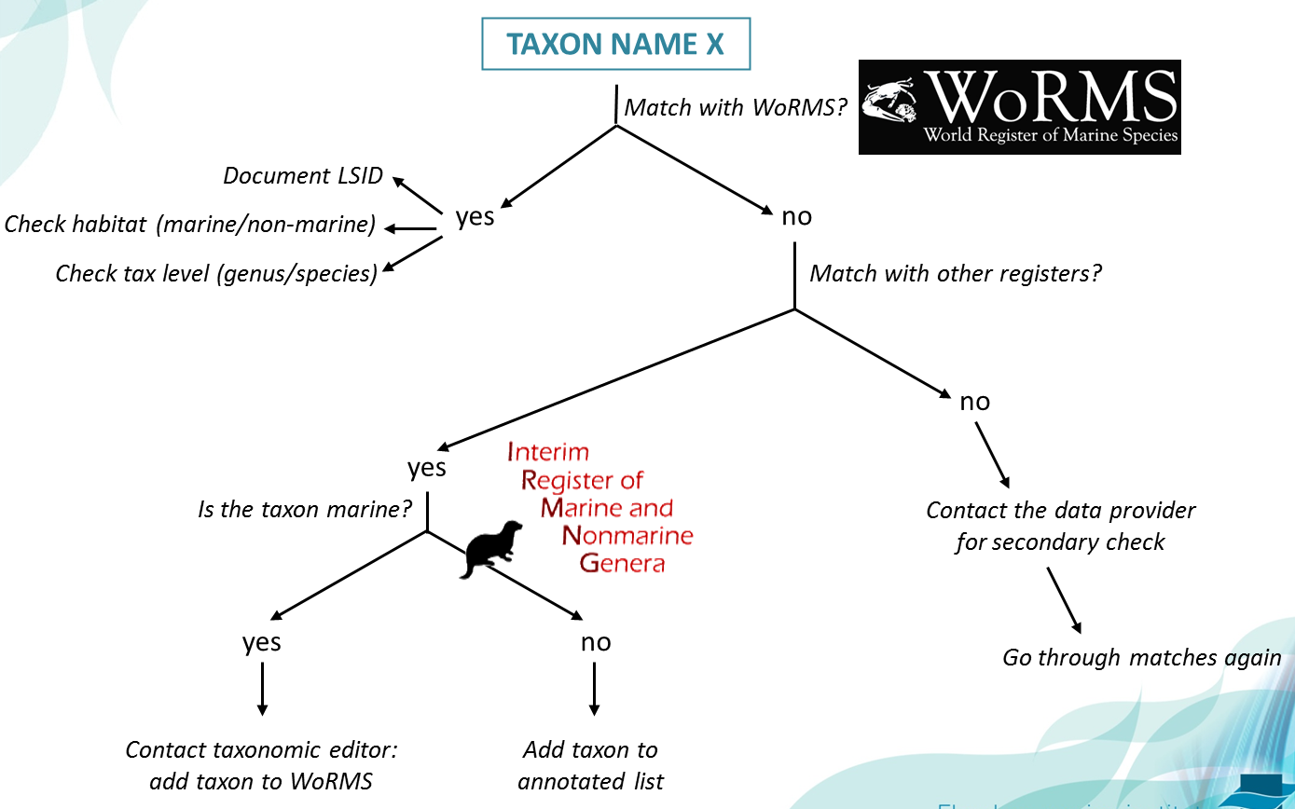

WoRMS – taxonomic backbone for OBIS
All OBIS taxon names are being matched against WoRMS
If no match is found in WoRMS, additional databases are consulted and – if necessary – the WoRMS editors are contacted for help

Slide 44
December 2012: ± 35,000 scientific names not matched to WoRMS
All names taken through matching process of previous slide
Notes:
So in 2015, when this slide deck was new, they were in the process of matching everything in OBIS with a real WoRMS entry. I don’t have the numbers now, but it’s mostly complete. everything that OTN adds has been verified in WoRMS, and it’s not to hard to verify your taxonomy against some part of the Aphia network, even the parts that aren’t WoRMS.
WoRMS editor(s) currently processing the names
WoRMS DMT working on update (e.g. AlgaeBase)
No WoRMS editor available for this group, so no way of verifying/correcting the name
WoRMS complete nonsense and needs to be sent back to the original provider for additional check

Slide 45



WoRMS – OBIS: mutual geographical quality control
Echinoidea example – Psammechinus miliaris
Needs checking in OBIS …
Notes:
A benefit of that harmonization is that both WoRMS and OBIS gain the geographical backstop that can be used to identify outliers in reported geography, and this sort of aggregation and comparison can run both ways.

Slide 46
Questions?
Read more:
Vandepitte, L.; Vanhoorne, B.; Decock, W. et al. (2015). How Aphia – the platform behind several online and taxonomically oriented databases – can serve both the taxonomic community and the field of biodiversity informatics. JMSE.
Costello, M.J.; Bouchet, P.; Boxshall, G. et al. (2013). Global coordination and standardisation in marine biodiversity through the World Register of Marine Species (WoRMS) and related databases. PLoS One 8(1): 20 pp. hdl.handle.net/10.1371/journal.pone.0051629
Appeltans, W.; Ahyong, S.T.; Anderson, G. et al. (2012). The magnitude of global marine species diversity. Curr. Biol. 22(23): 14 pp + suppl. inf (91 pp.). hdl.handle.net/10.1016/j.cub.2012.09.036
Notes:
So that’s the background on WoRMS. It can be an important step in a good QA/QC process

Slide 47

AQUATIC ANIMALS
Highly valued aquatic resources in a rapidly changing environment
Global food security
Billions of dollars per year in socioeconomic benefits
Structure healthy ecosystems and their resilience
Biological Essential Ocean Variables (GOOS)
Are culturally and globally significant
OCEAN TRACKING NETWORK

Slide 48

TAG TECHNOLOGY
Acoustic tags, satellite tags and data loggers
New tags have advanced the concept of mobile tracking to include large aquatic animals capable of documenting interactions with their surroundings, including environmental conditions and other tagged animals.
OCEAN TRACKING NETWORK

Slide 49


HOW TRACKING WORKS
Acoustic tags are small transmitters that allow researchers to track aquatic animals underwater.
Larger animals can carry Vemco Mobile Transceivers (VMTs), which act as both transmitters and receivers.
Wave Gliders float on the ocean’s surface. They are emission free, propelled by wave energy and solar powered.
Slocum Gliders dive up and down collecting information underneath the waves.
Acoustic receivers capture animal movement data.
OCEAN TRACKING NETWORK

Slide 50

ACOUSTIC RECEIVER MOORINGS
Recovery timelines
Rollovers
Offloads
Bluetooth
Acoustic
OCEAN TRACKING NETWORK

Slide 51

GLIDERS
Changing the way we study the ocean
Emission-free, cost-effective, and autonomous
Remotely offloads fixed tracking stations
Provides oceanographic context and equipment to track animals
Doesn’t get sea sick!
Wave glider: wave driven, powered by solar energy
Slocum glider: buoyancy driven, powered by lithium battery
More than____ km travelled since…
OCEAN TRACKING NETWORK

Slide 52

ROV: REMOTELY OPERATED VEHICLE
Saab Seaeye Falcon
Depth Rating up to 300 metres
Alternative recovery method
Film footage
Other projects
OCEAN TRACKING NETWORK

Slide 53



TRACK, CONNECT, TRANSFORM
Together, OTN and its collaborators are tracking oceans, connecting people and transforming knowledge
TRACK Using electronic tags to track more than 225 keystone, commercially important and endangered species.
CONNECT Connecting infrastructure, communities, resources, researchers, policy-makers, industry, and other stakeholders at local and global scales
TRANSFORM Transforming our understanding of the oceans by developing global data standards and a paradigm of collaborative research and management.
OCEAN TRACKING NETWORK

Slide 54

TRACK
Mysterious migrations of American eels
American eels are one of the most endangered fishes in North America
Their story begins and (usually) ends in the Sargasso Sea
Migrate to inland waters for 10 to 25 years
Return to Sargasso Sea to spawn
Journey first tracked by OTN researchers; revealed two-phase migration
Understanding routes and migration cues will help with conservation planning
OCEAN TRACKING NETWORK

Slide 55

CONNECT
Underwater robots tracking right whales and their prey
Gliders listen for baleen whale calls off the Scotian Shelf and Gulf of St. Lawrence
Capture the abundance of whale prey: zooplankton
Partnership with Canadian Wildlife Federation & MEOPAR (WHaLE)
Understand migration routes and habitat use
Scientific basis to establish policy and protected habitats
Reduce accidental ship strikes and fishing gear entanglements
OCEAN TRACKING NETWORK

Slide 56

TRANSFORM
First Nations Fisheries
Most Pacific salmon migrate in to the open ocean only once in their lives
Return to natal spawning grounds
Heavily targeted by fisheries
OTN is generating movement data in partnership with DFO, Indigenous peoples, ENGOs & harvesters
Transforming fisheries management approaches
Boosting conservation of Pacific salmon in B.C.
OCEAN TRACKING NETWORK

Slide 57

INFORMING POLICY
Sustainable management of emerging fisheries
1960s: Inuit communities developed Greenland halibut fishery in northern Cumberland Sound, N.U.
Divided from international fishing waters in southern portion of the Sound
Halibut populations were thought to be distinct
OTN research showed fish were crossing north and south boundary on a seasonal basis
Management line has been moved to encompass entire Cumberland Sound
More sustainable for both the Greenland halibut population and the community
OCEAN TRACKING NETWORK

Slide 58

OTN IN NUMBERS
47,500
614
212
75,000
TAGGED ANIMALS TRACKED
SENIOR SCIENTISTS
SPECIES TRACKED
GLOBALLY
KM COVERED BY GLIDERS
OCEAN TRACKING NETWORK

Slide 59



@oceantrackingnetwork
@oceantracking
oceantrackingnetwork.org

